Slide 1
Module 19

Slide 2

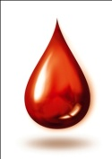

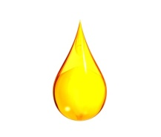
CIRCULATION
BLOOD
LYMPH
Now let us learn about lymph

Slide 3

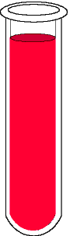
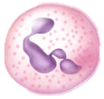
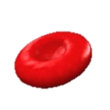

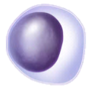


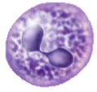
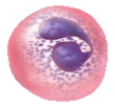
Blood
Blood is made up of two components
So, if we remove the cells from the blood what remains is plasma.
Liquid
Cells
Plasma
RBC
WBC
Platelets
Plasma is made up of water,
proteins
and dissolved solutes.
Plasma
Blood

Slide 4
When blood flows through the capillaries,
This forms the tissue fluid.
Some amount of water, proteins and dissolved solutes escape out from the pores of the capillaries into the tissue spaces.
Lymph drains into lymphatic capillaries from the tissue spaces which finally open into the veins.
Lymph carries digested and absorbed fat from the intestine and drains excess fluid from extra cellular space back into the blood.
It is also called as lymph. It is light yellow in colour.
It is similar to blood plasma except that it has very less amount of proteins in it.
Artery
Capillary
Heart
Tissue Fluid
Tissue spaces
Lymphatic capillaries
Tissue
Vein

Slide 5
Thank You

